Slide 1
Software Configuration Management
Video Link:https://www.youtube.com/watch?v=ce73O3pkgbU
By: M.Aamir Saleem MS (SPM) For queries contact: amir.saleem@gift.edu.pk

Slide 2
Configuration Management
"Set of polices, processes and tools we use to manage changes in s/w & related documentation"
Systematically manage, organize, and control the changes in the documents, codes, and other entities during the Software Development Life Cycle.
To control cost
To minimize the work effort involved in making changes
Increase productivity and minimize mistakes

Slide 3
Configuration Management
Why do we need Configuration management?
Multiple people working on software
Geographically distributed teams works concurrently
Changes in user requirement, policy, budget, schedule need to be monitored
Develop coordination among stakeholders
Minimize the slip from the track

Slide 4
Configuration Management Plan
The SCMP process planning begins at the early phases of a project.
The SCMP can follow a public standard like the IEEE 828 or organization specific standard
It defines the types of documents to be management and a document naming. Example Test_v1
SCMP defines the person who will be responsible for the entire SCM process and creation of baselines.
Fix policies for version management & change control
Define tools which can be used during the SCM process
Configuration management database for recording configuration information.

Slide 5
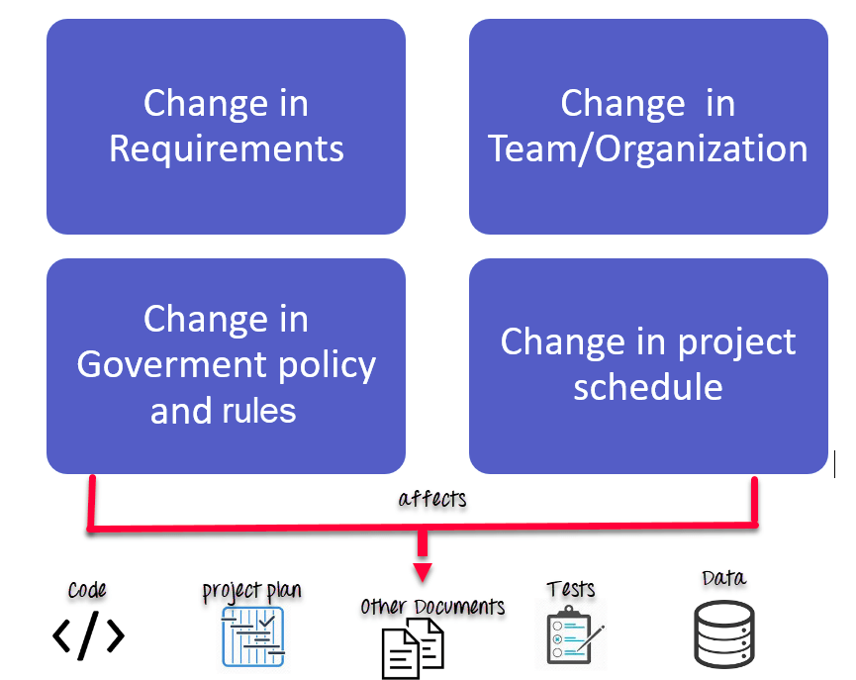
Configuration Management
Any change in the software configuration Items will affect the final product.
S/W Dev
S/W Validation
S/W Evolution
SCM

Slide 6
Configuration Management
Activities in SCM
Change Management
Version Management
System Building
Release Management

Slide 7
Configuration Management
Change Management
Keep track of change requests coming from customer or dev.
Check the cost and impact of change
Change is really required?
When a change will be implemented?

Slide 8
Configuration Management
Version Management
Keep track of version number of Codeines
Changes made by different dev don't interface each other
Process of managing baseline
CI, VERSION, CODELINE, CHANGE, BASELINE

Slide 9
Configuration Management
Version Management System
Version and release identification
Storage Management
Record change history
Independent development by different teams
Git, TFS, Bitbucket
Version management system, workspace , checkout , check in
Branching and merging the code

Slide 10
Configuration Management
Intro to Github
Using git and GitHub
Difference between Git and GitHub
Git Repositories
Track changes in your code across versions
Install git and create a GitHub account

Slide 11
Configuration Management
System Building
Assembling all s/w components to make a working system
Check previous s/w build from VM and decide what should be next build
Keep track of testing enviroment
Check and balance of Timestamp
System building and version management systems must communicate
Configuration file is used for creating baseline
Jenkins

Slide 12
Configuration Management
Build Platform
Development System
Build Server
Target Enviromint
Workspace​
Target
VMS
Build Server

Slide 13
Configuration Management
Release Management
Keep track of releases to customer
Keep track of all other kind of releases
Major and Minor Relapses
Example # V.8.2.1

